Slide 1

Categorization of Resumes for Enhanced Job Matching Team 5
Lahari Maddula
Pradeepti Dokka
Sai Deepika Bandari
Sanchita Godse
Shuang Ma

Slide 2






Index
Introduction
Data Description
Data Preprocessing
Model Description & Results
Business Insights
Conclusion & Future Recommendations

Slide 3
Introduction to Resume Classifier
The recruitment landscape is increasingly competitive and complex, with companies striving for efficiency in identifying the right candidates. The traditional approach to resume screening is labor-intensive and prone to biases. Automating the categorization of resumes through text mining can streamline the recruitment process, reduce biases, and ensure that job seekers are matched with roles that best fit their qualifications.
Challenge: Traditional recruitment struggles with efficiently matching candidates to jobs.
Solution: Applying text mining to categorize resumes for precise job matching.
Tools: Utilizing SAS Enterprise Miner Workstation 15.1 for advanced data analysis.
Impact: Streamlining recruitment, improving candidate-job alignment.

Slide 4
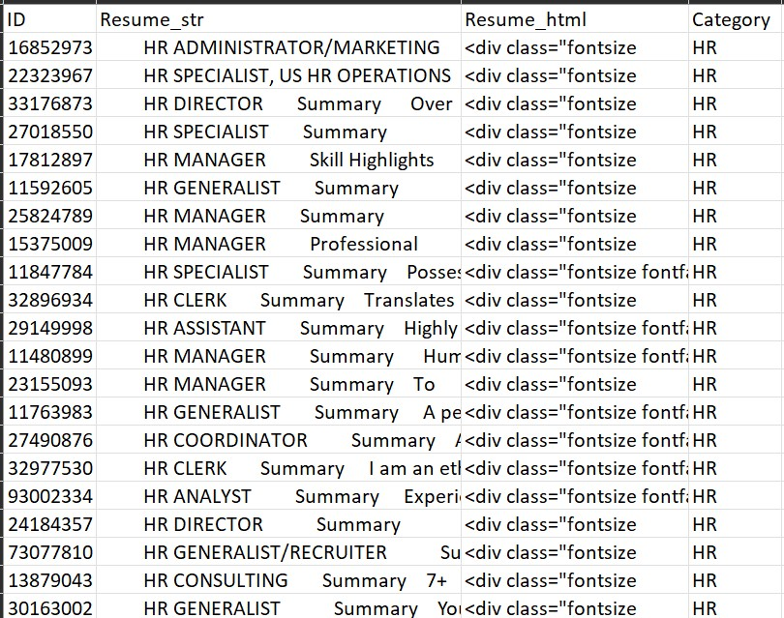
Data Description
The dataset comprises over 2400 resumes sourced from livecareer.com, a reputable career resource platform.
The csv file contains 4 columns:
Resume_str: Contains the resume content in plain text format.
ID: Unique identifier for each resume, also serving as the filename.
Resume_html: HTML format of the resume, obtained from web scraping.
Category: Job category for the resume, including HR, IT, Education, Legal, and more.
Data Source: https://www.kaggle.com/datasets/snehaanbhawal/resume-dataset

Slide 5
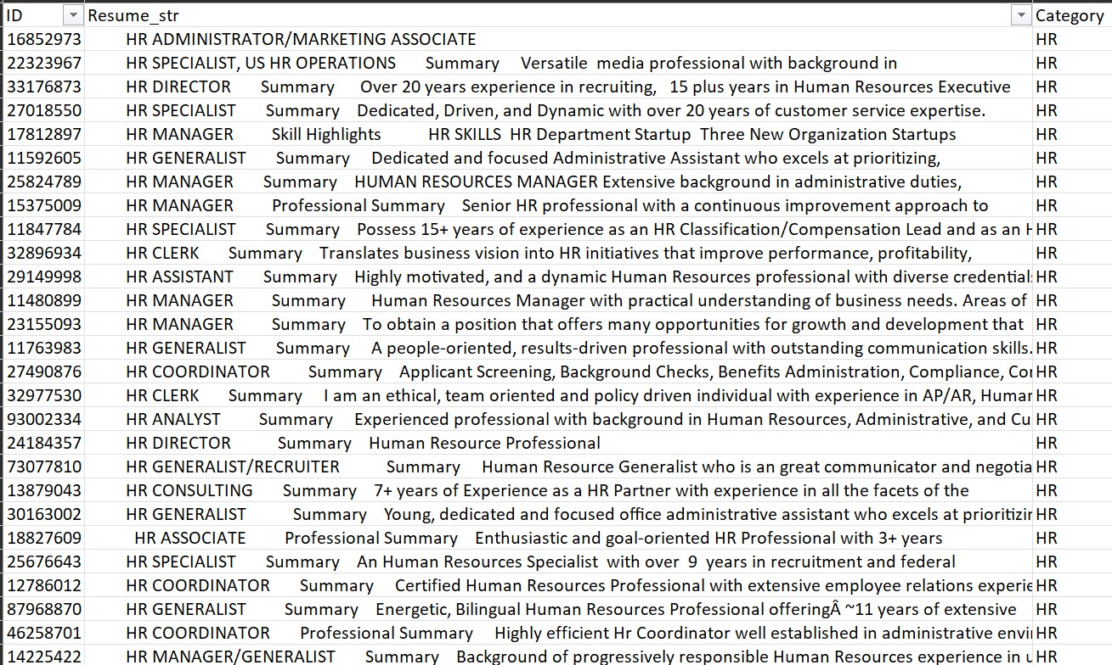
Data Preprocessing
Null & Missing Values: Identified and rectified nulls using Python pandas, improving data accuracy.
Column Cleanup: Dropped the irrelevant 'Resume_html' column to streamline our dataset.
Special Character Handling: Employed Regular Expressions to remove non-essential characters in the Resume_str column, ensuring data quality.

Slide 6
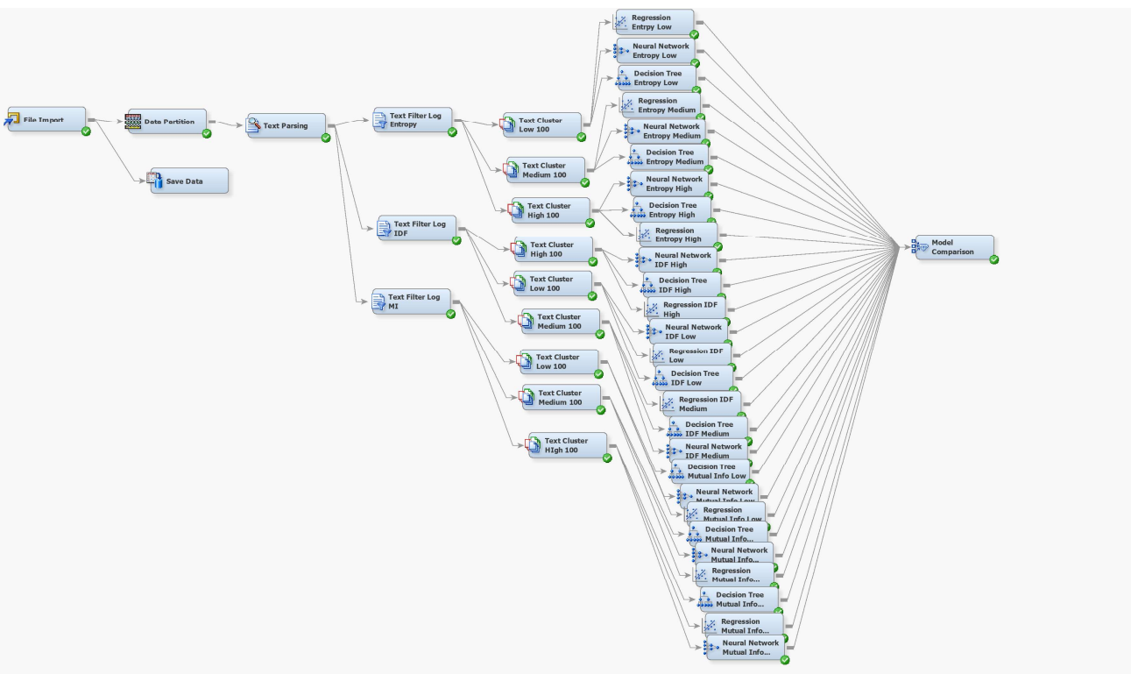
Model 1:

Slide 7
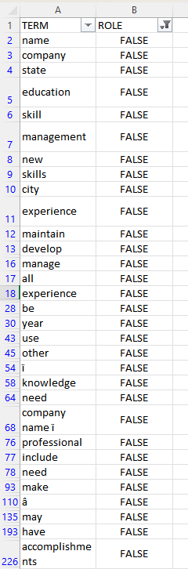
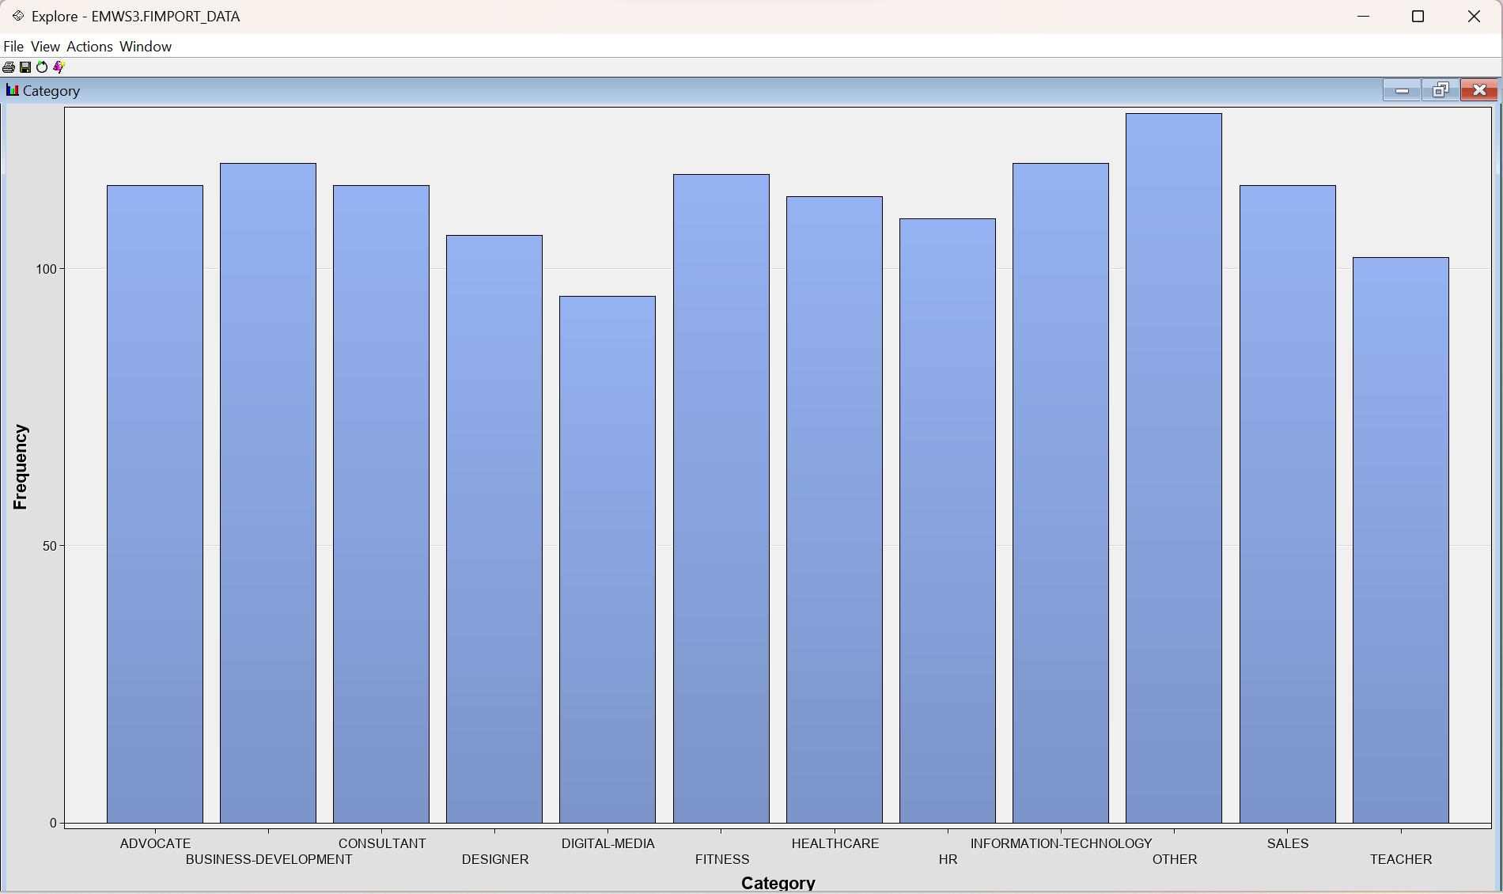
Model Description
File Import
Text Filter:
Frequency Weight: Log
(As the Target variable is classified into different categories)
Term weight: Mutual Information, Entropy, IDF, Default
Text Parsing:
Updated Stop List based on the data.
Data Partition:
Train : 50,Validation:30,Test:20

Slide 8
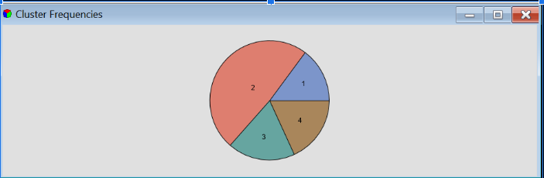
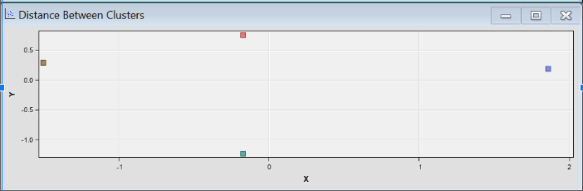
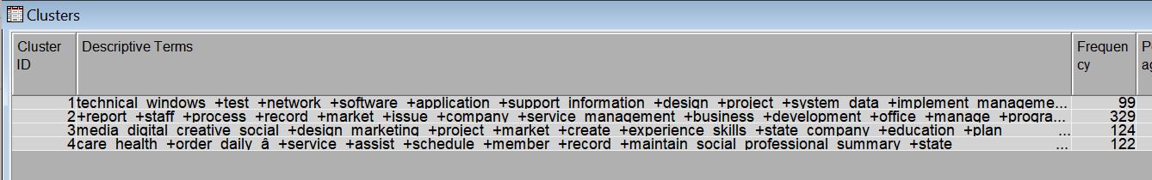
Text Cluster:
High SVD 100, Low SVD 100,Medium SVD 100
Cluster Configuration: Maximum 12

Slide 9
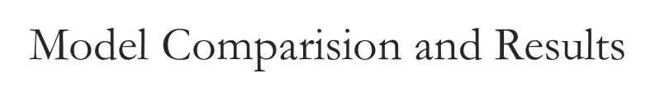
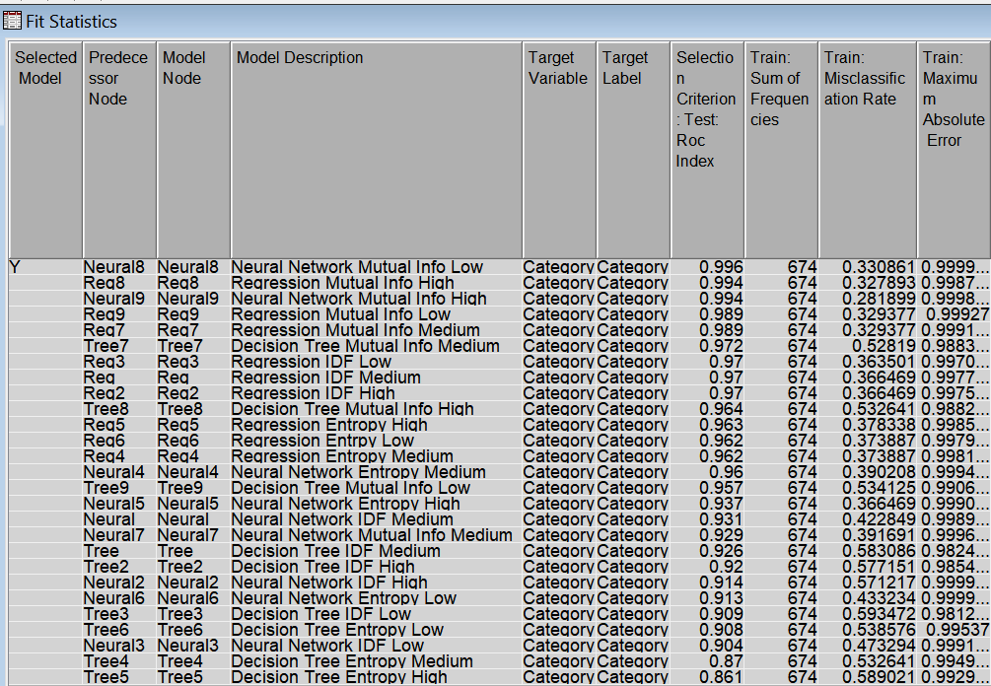
Models Tested:
Decision Tree
Regression
Neural Network
Inference:
Term Weight:
Mutual Information Models are showing better ROC, Misclassification rate

Slide 10
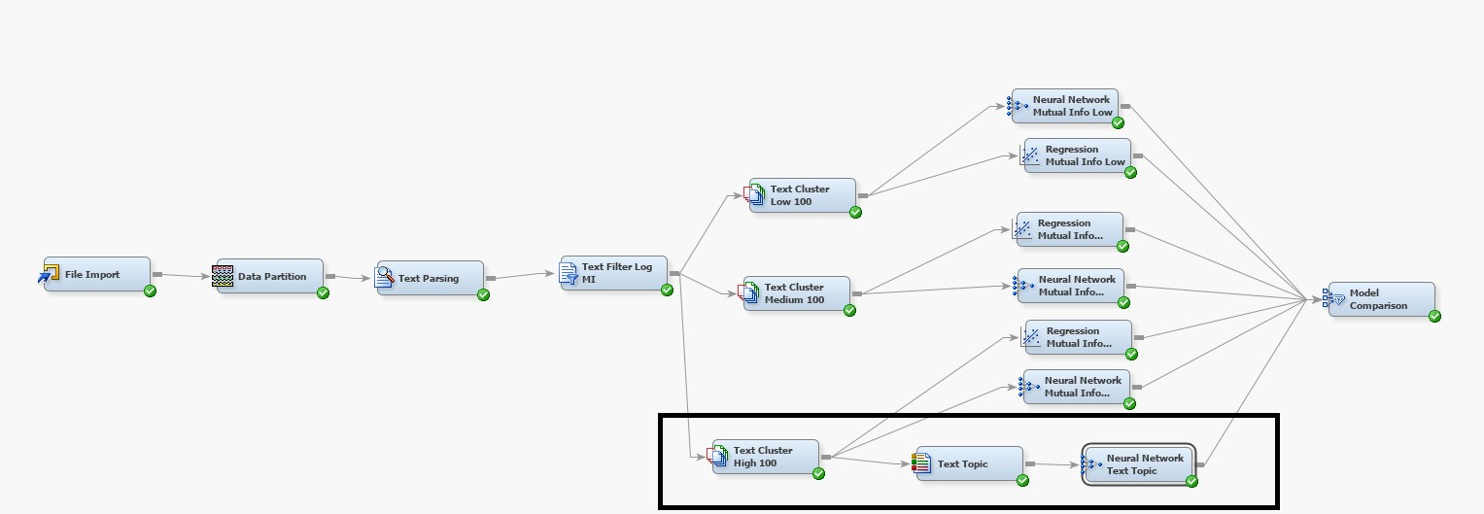
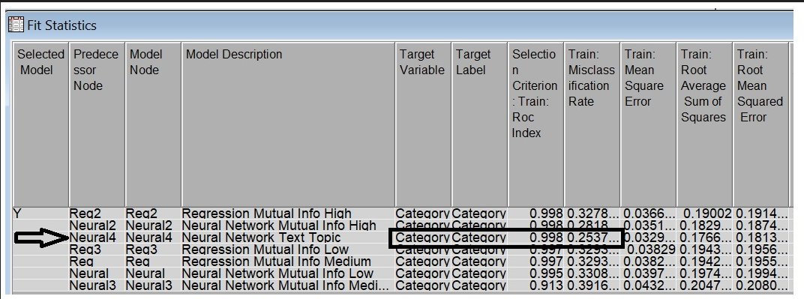
Best Model and Results
Neural Network with Text Topic is our best Model.
Both Regression and the Neural network with Mutual Information yielded the same ROC Index, but they had different misclassification rates. After incorporating Text Topic into the neural network, it achieved a better misclassification rate of 25%.

Slide 11
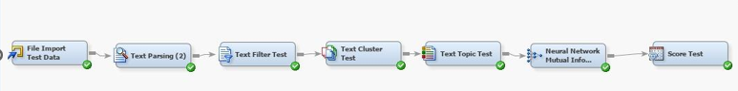
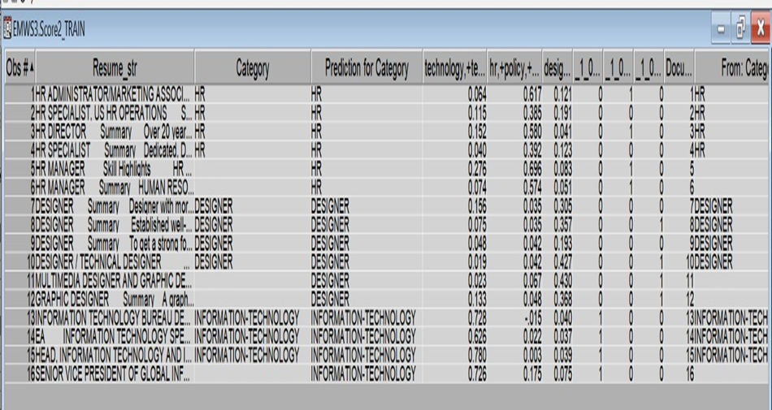
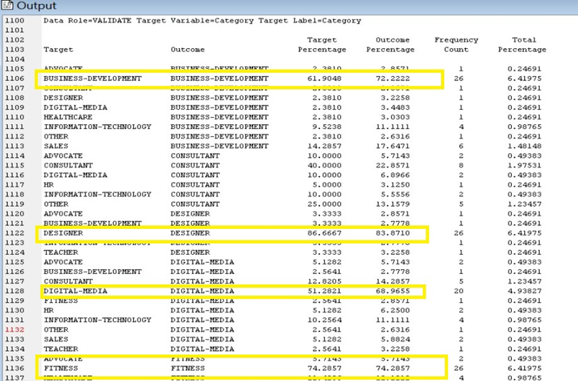
Test results for the Best Model

Slide 12
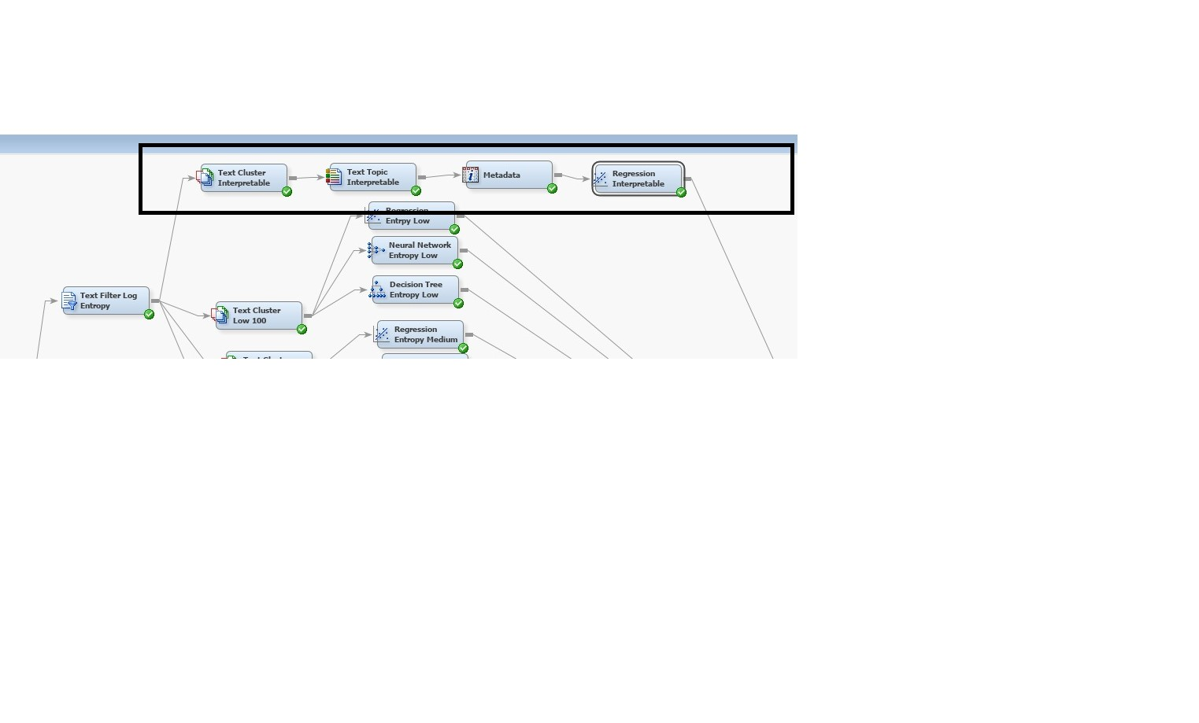
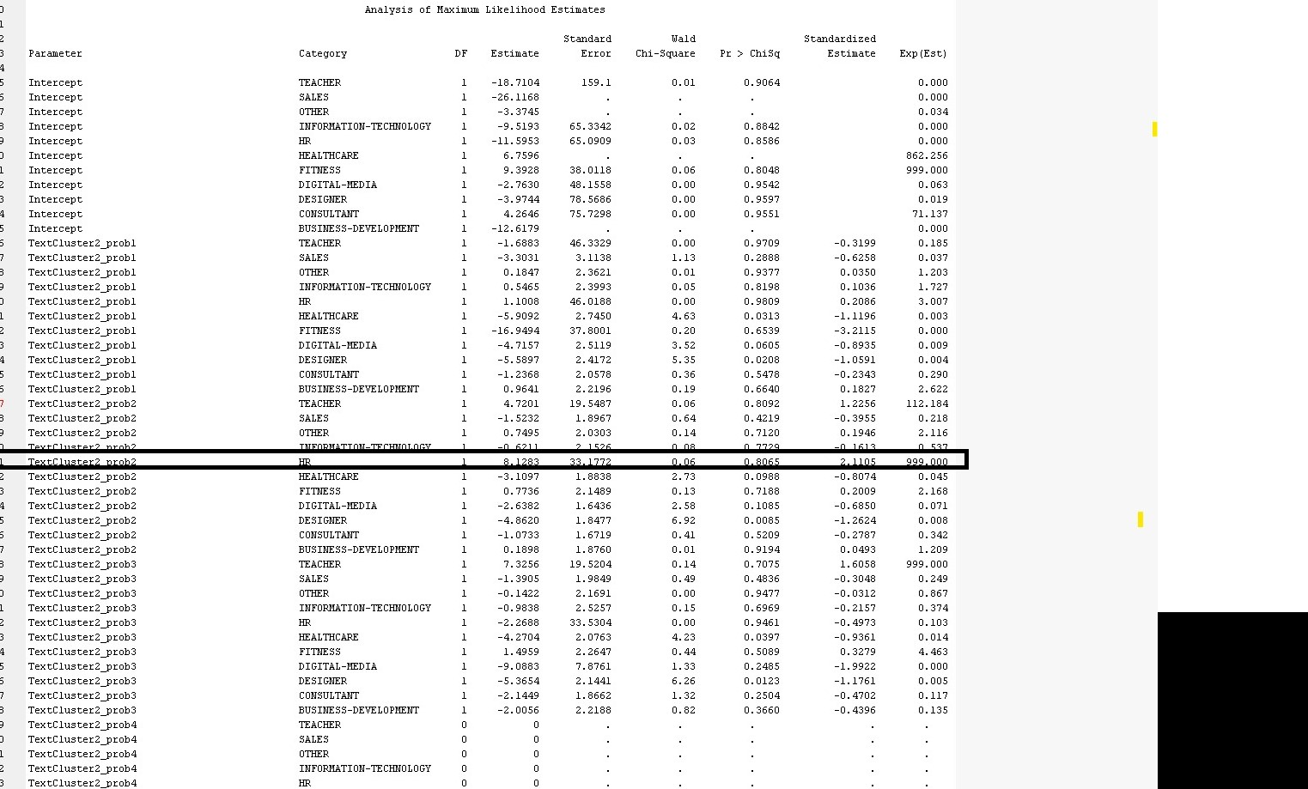
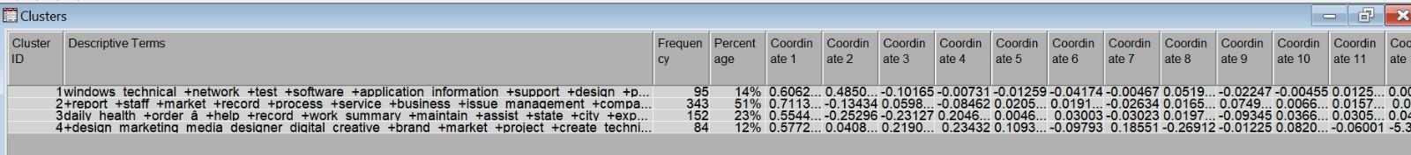
Interpretable Model

Slide 13

Future Recommendations
Advanced Candidate Identification:
Objective: To uncover hidden talents by identifying specific skills and
experiences beyond job titles and keywords.
Impact: Expands the pool of qualified candidates for each position.
Automating Resume Screening:
Goal: Implement automation in the initial resume screening process.
Benefit: Recruiters can focus on strategic tasks like interviews and hiring decisions.
Caveat: Maintain a balance to ensure automation complements but doesn’t entirely replace human judgment.
Natural Language Job Search System:
Development Plan: Create a system for job search using natural language queries.
Advantage: Makes it easier for candidates to find and apply to relevant positions matching their skills and interests.

Slide 14
Thank You

